Slide 1
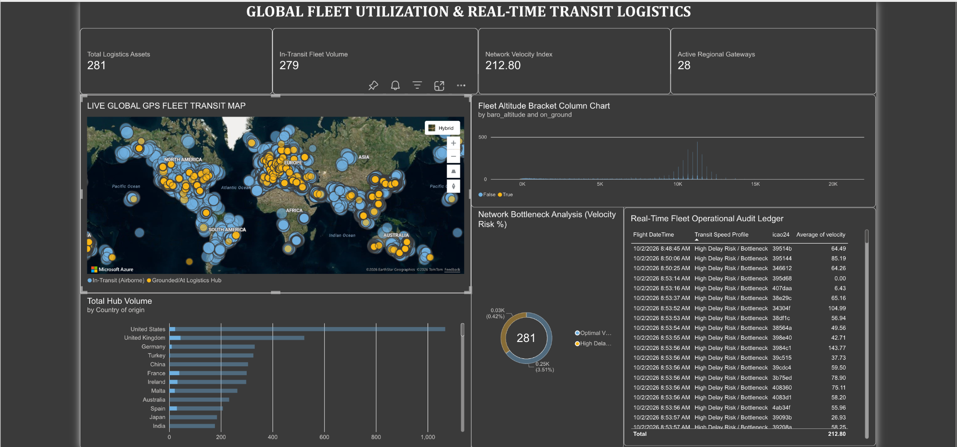
The Business Idea: Track real-time global flight data to monitor fleet status and catch transit delays early.
What I Did: I built an interactive 8-chart dashboard that displays active asset metrics, live GPS coordinates, and bottleneck risk categories.
GLOBAL FLEET UTILIZATION & REAL-TIME TRANSIT LOGISTICS DASHBOARD

Slide 2
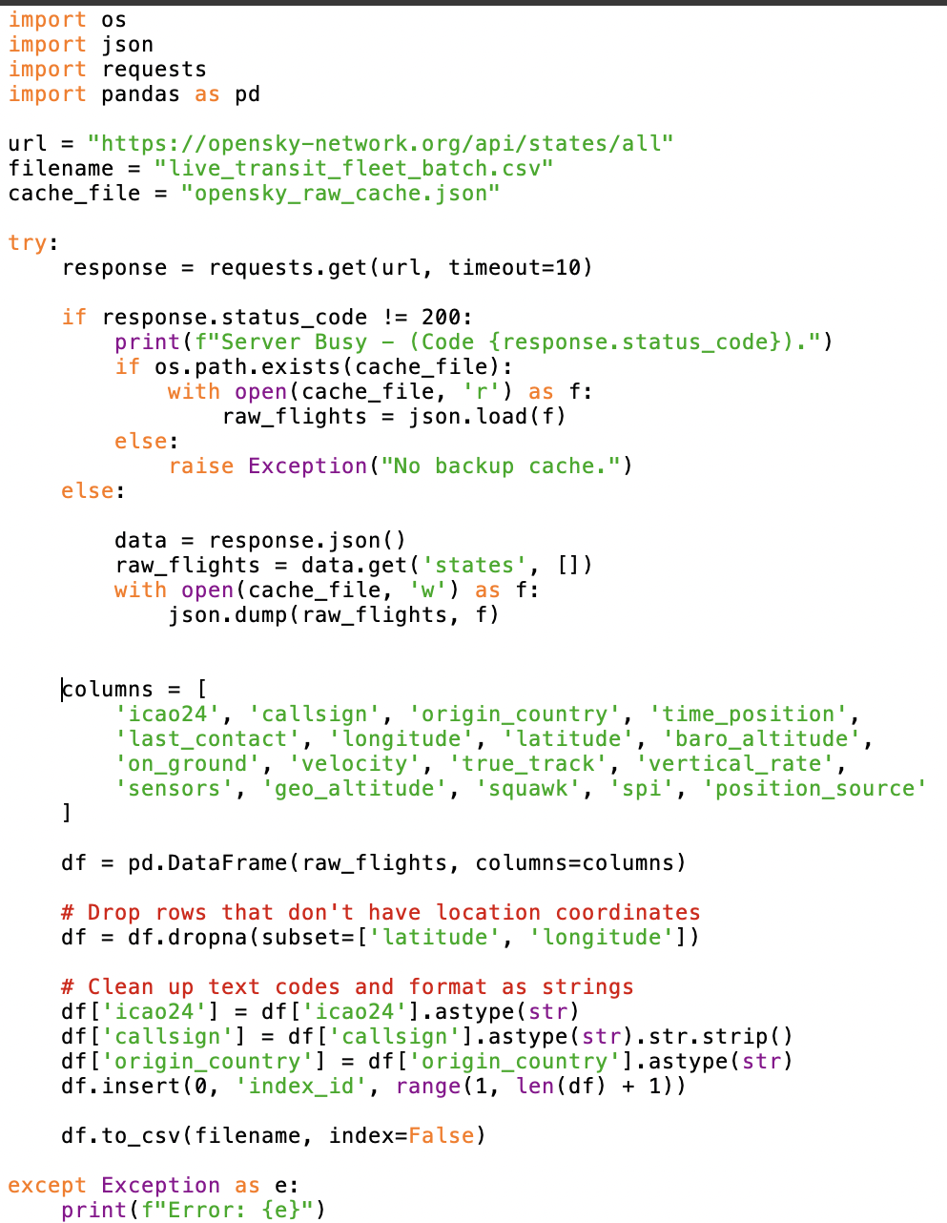
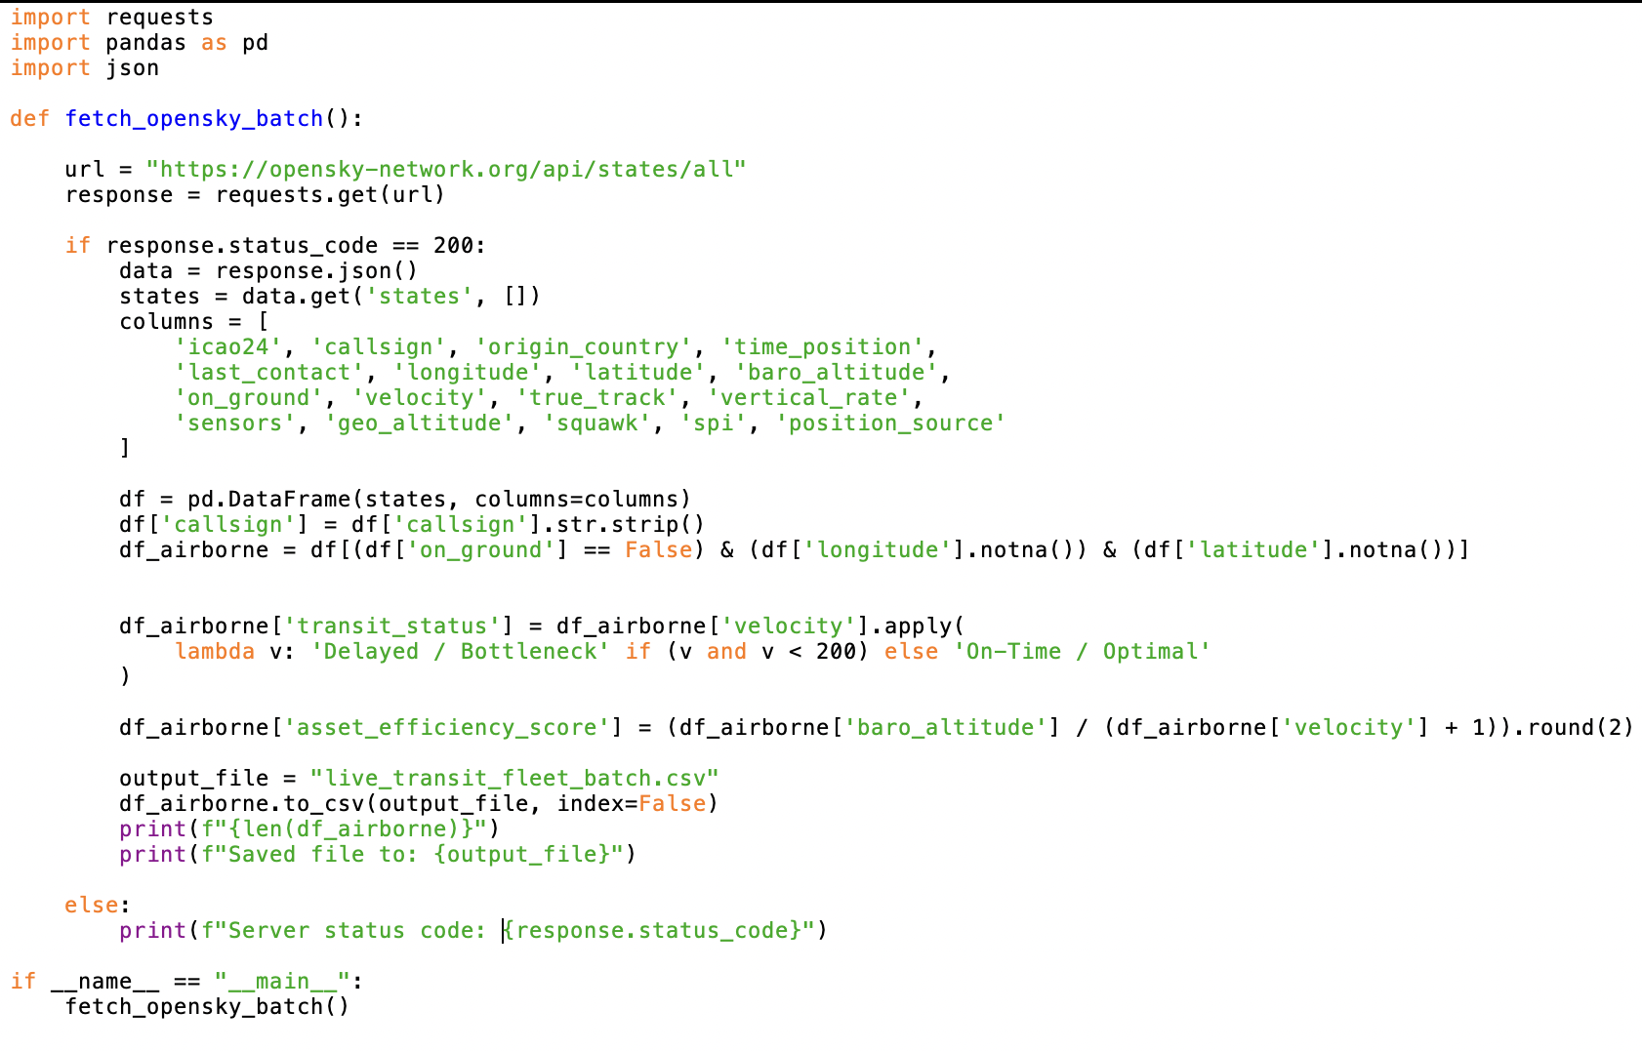
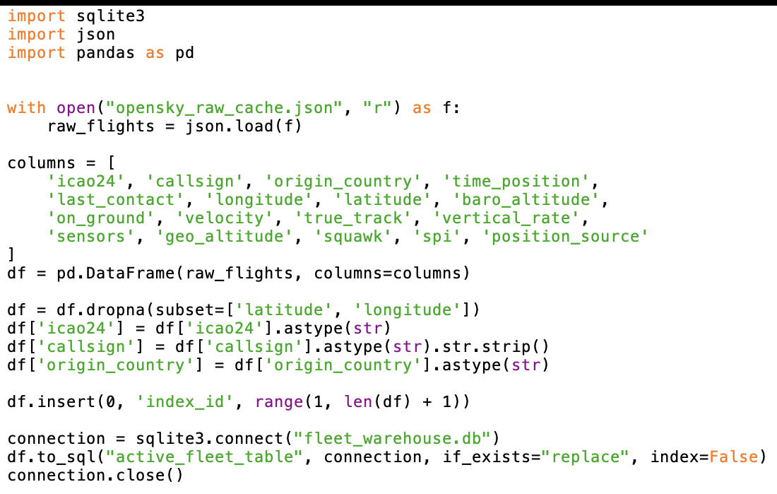
What I Did: I coded a 3-part Python pipeline that pulls live OpenSky API telemetry, cleans missing GPS data, and injects a custom speed classification logic using Pandas.
Storage & Automation: The scripts automatically manage local JSON caching to prevent server timeout losses and instantly upsert the structured records into a SQLite database.
Data Pipeline & Warehouse Setup (Python)

Slide 3
- In aviation logistics, equipment downtime and unexpected transit delays directly lead to broken supply chains and missed delivery deadlines. To fix this, operations teams must constantly track fleet utilization knowing exactly which cargo planes are actively moving in the air versus which ones are sitting idle on the tarmac.
- However, because raw sensor data was trapped in unreadable 10-digit Unix integers (like 1790930469), Power BI could not filter the data chronologically or sort it by hours and minutes. This data limitation created a massive tracking blind spot, making it impossible to separate airborne planes from grounded inventory or flag where shipping streams were backing up.
- Wrote a custom Power Query datetime formula to convert those raw numbers into human-readable calendar dates and precise clock times. Configured and scheduled automated batch updates to stream this live tracking data directly into the dashboard.
- Key Learnings: Learned how to seamlessly bridge an automated Python ETL backend with a live, cloud-based Power BI dataset. This project proved that transforming raw telemetry integers into a structured time-series model is critical for resolving high-stakes operational blind spots.
Business Problem

